Slide 1
Some 250 women – some 50 countries
https://womenagainstnato.org/

Slide 2
U.S. Secretary of State James Baker’s famous meeting with Soviet leader Mikhail Gorbachev February 9, 1990

Slide 3
1949: 12 founding members Since then: 19 more countries have joined NATO through nine rounds of enlargement (in 1952, 1955, 1982, 1999, 2004, 2009, 2017, 2020 and 2023 = 31

Slide 4
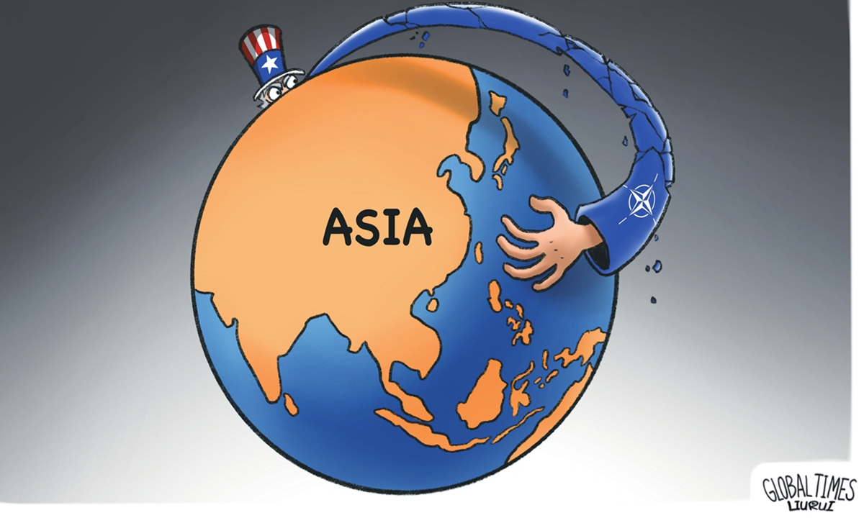

Slide 5
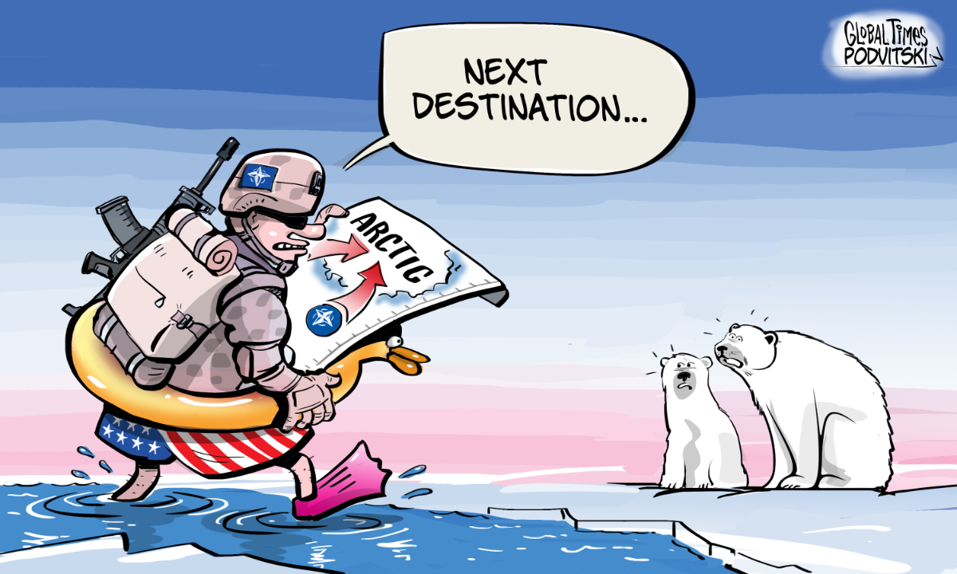

Slide 6
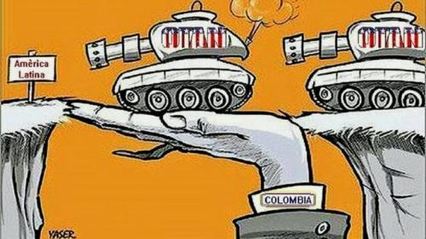

Slide 7
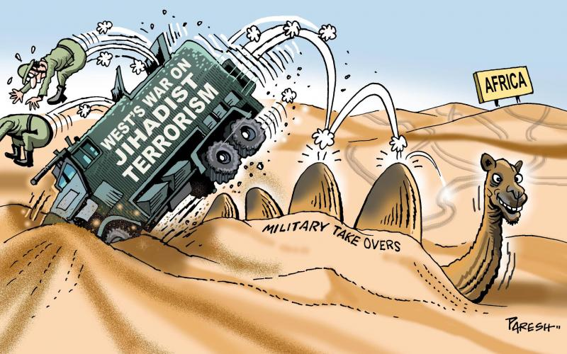

Slide 8
May 2023
Pope Francis
NATO may have caused Russia’s invasion of Ukraine
Transatlantic military alliance was ‘barking’ at Russia’s door.

Slide 9
What do Global Women for Peace United
Against NATO want?
NO to global NATO
No to increasingly militarised blocs
No to war as a way of settling international disputes.
No to the militarization of scientific research
No to the involvement of women in patriarchy's war plans.
No to any ‘gender approach’ in NATO.
Putting women in top roles in a warmongering military organization will do nothing to promote the principles of equality, justice and peace that underlie women’s struggles for freedom.

Slide 10
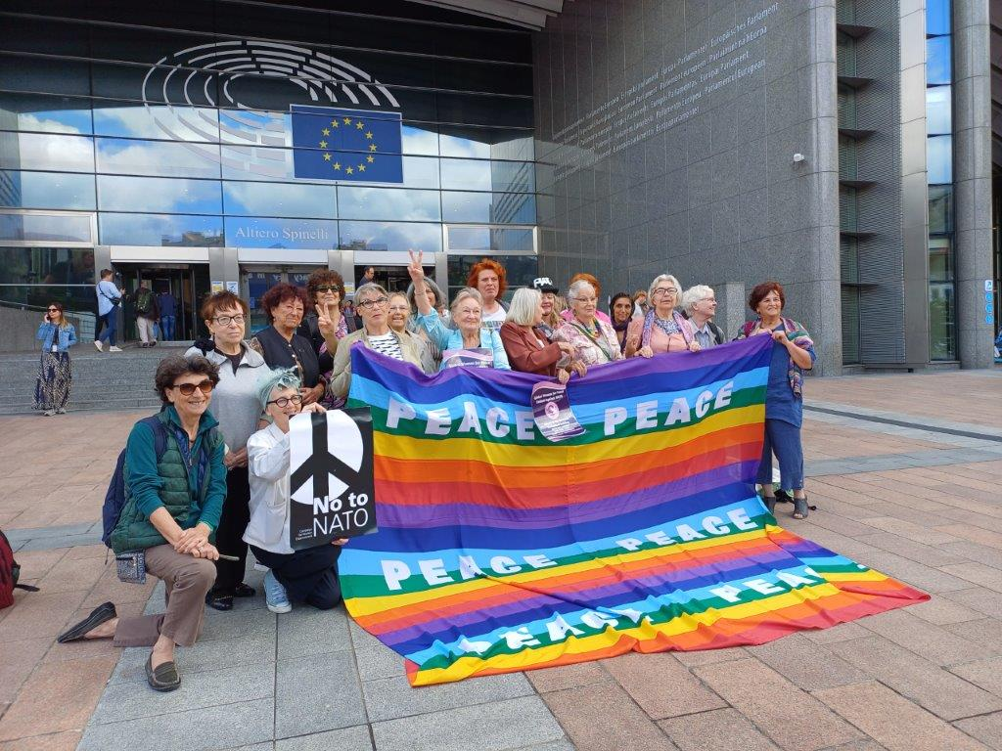

Slide 11
Meeting in the European Parliament with
Clare Daly MEP (Ireland/independent/Left-green group) Özlem Demirel MEP (Germany/left)
Audience at NATO headquarters – handing over Declaration Against NATO to Nicola di Santis
(Head of the Engagements Section in the Public Diplomacy Division of the NATO Headquarters in Brussels)
Event: In Brussels – 2 days - 60 pers - Online 250 pers
Webinars Nato in:
- Europe
- US/Canada
- Africa
- Asia Pacific
- Latin America

Slide 12
Clare Daly – MEP – Independents for change/Ireland –
Left/Green group
“I can’t tell you how happy I am that this event is taking
place, and that the Global Women for Peace United Against
NATO declaration has been produced and circulated.
It has never been more needed. Because feminism has been
ruthlessly co-opted by the military industrial complex.
A succession of young, glossy female politicians and media
personalities have been pushed to the fore across Europe to
argue on NATO’s behalf, to argue for more war, more
militarism, more arms spending...
War and militarism are anathema to feminism. They are
opposites, they cannot be reconciled...
We have to be loud in calling that out. We have to be crystal
clear in our position that girl-washing militarism is an act of
breathtaking cynicism that we will not stand for.”

Slide 13
Demonstration – part of International Peace Wave
Live peace actions in streets and squares; rallies, concerts, artwork creation, blood drives, installation of peace poles, dances, speeches, and various public demonstrations. Moving around the globe with the sun.

Slide 14
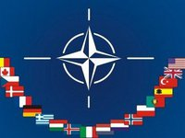
The next summit of the NATO will be held in Washington in July 2024
Biden has invited NATO
We are coming too, to protest against Global NATO - it belongs to the dust bin of history

